Slide 1


SecureVault
Secure Password Manager
PRESENTED BY:
25MVCSMR0045
25MVCSMR0049
25MVCSMR0062
25MVCSMR0077
Notes:
SecureVault is a full-stack MERN password manager built around authenticated encryption (AES-256-GCM), per-user key derivation, and email OTP two-step login.

Slide 2
01 | Problem & Objectives
Why a secure password manager is useful
The Problem
Project Objectives
• People manage many online accounts.
• Reusing or choosing weak passwords increases risk.
• Storing credentials as plain text can expose sensitive information.
• Store website credentials in encrypted form.
• Protect access through authentication and email OTP verification.
• Provide password generation and security audits.
• Offer a responsive, easy-to-use dashboard.
Core goal: make credential management safer without sacrificing usability.
02 / 07

Slide 3


Technology Stack
Frontend
Backend
React 18 + Vite
React Router DOM v6
Axios with token interceptors
Lucide React icons
Custom CSS theme tokens
Node.js 20+ and Express.js
MongoDB / Atlas + Mongoose
JWT + HTTP-only cookies
Nodemailer (Gmail SMTP)
bcryptjs, native crypto
Helmet, rate limiting, CORS
THEME TOKENS
Indigo accent
Dark-mode accent
Dark page
Light card
Notes:
Standard MERN split with security middleware on the Express side. The UI uses CSS custom properties so light and dark themes switch without a flash.

Slide 4
REST API & Project Structure
7
/api/auth
PROJECT STRUCTURE
Register, login, OTP verify & resend, me, logout
Program_files/
├─ backend/
│ ├─ config/ controllers/
│ ├─ middleware/ models/
│ ├─ routes/ services/
│ └─ utils/ server.js
├─ frontend/src/
│ ├─ components/ context/
│ ├─ pages/ services/
│ └─ styles/ utils/
└─ package.json README.md
8
/api/credentials
CRUD, favorites, stats, security analysis
2
/api/users
Profile and master password updates
Notes:
Seventeen endpoints across three route groups. Credential routes return masked data by default; plaintext is fetched on demand per credential. The structure separates controllers, services (crypto, email) and utils on the backend, and components, context and pages on the frontend.

Slide 5




Two-Step OTP Authentication
Check password
Email OTP
Verify code
Issue JWT
Master password verified with bcrypt, 12 salt rounds
6-digit code from crypto.randomInt via Gmail SMTP
HMAC-SHA256 hash compared with timingSafeEqual
HTTP-only cookie session, only after OTP success
5 min
5 tries
60 s
OTP auto-expiry
then challenge is cancelled
resend cooldown, old OTP voided
Notes:
Both registration and login require an emailed OTP. OTPs are stored only as HMAC-SHA256 hashes, are single-use, and no JWT is issued until verification succeeds.

Slide 6
Tested & Production-Ready
8
automated security
test suites
PRODUCTION CHECKLIST
1
HTTPS everywhere with HSTS
2
Load keys from a KMS or secret manager
AES-GCM round-trip and tamper rejection
Multi-tenant key isolation
OTP hashing, timing-safe checks, expiry
Strength scoring, userId-scoped queries
3
Restrict Atlas to private VPC IPs
4
Secure, httpOnly, sameSite-strict cookies
5
Auto-lock after 15 min of inactivity
Zero plaintext. Zero cross-tenant access. Zero JWT before OTP.
Notes:
Run the suite with npm run test:backend. Close with the three guarantees the design is built to provide.

Slide 7
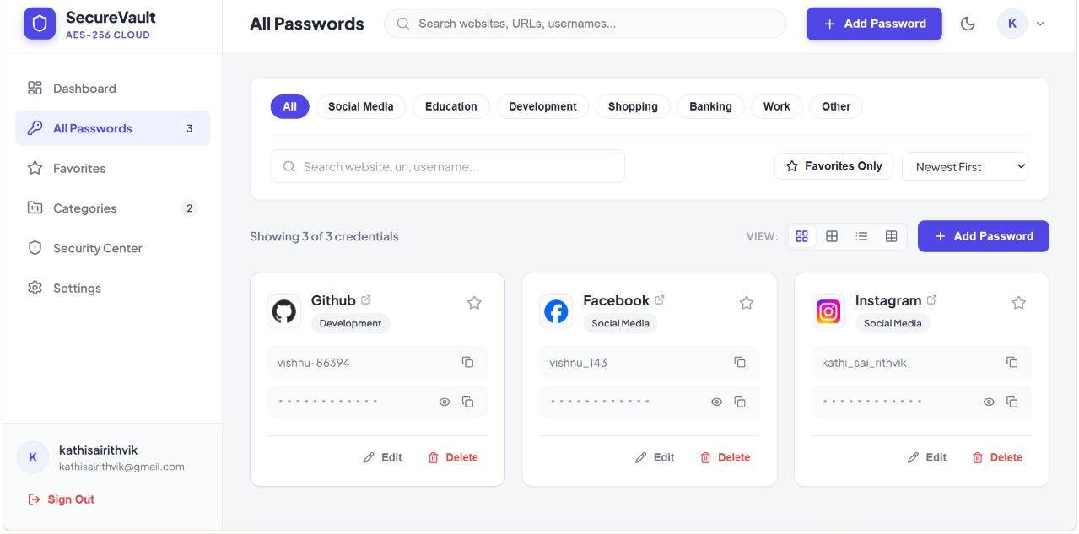
DEMO:
Notes:
Six headline capabilities. Also included: full CRUD with confirmation dialogs, on-demand reveal of decrypted passwords, a live stats dashboard and a fully responsive layout.

Slide 8





Core Features
Zero-Plaintext Storage
Tenant Isolation
Gmail OTP Login
Every credential encrypted with AES-256-GCM
Separate HKDF-derived key per user
6-digit code on register and every login
Reuse Audit
Password Generator
4 Views + Themes
Blinded fingerprints find reused passwords
Web Crypto API, 8–48 chars, custom sets
Cards, list, table; zero-flash dark mode
Notes:
Six headline capabilities. Also included: full CRUD with confirmation dialogs, on-demand reveal of decrypted passwords, a live stats dashboard and a fully responsive layout.

Slide 9


